Slide 1
Smart Security System
Under Guidance of
Prof. Shridhar K
Project team:
Mohammed Rahil Shiraz (3PD16EC053)
Mohammed Ikramuddin (3PD16EC052)
Ankush Maharaj (3PD16EC018)
Aravind Jinde (3PD16EC021)

Slide 2
Index
Introduction
Problem Statement
Objectives
Block Diagram of Security System
Hardware Components
Specification of Hardware Components
Circuit Connection
Working of System
Software Design
Flowcharts
Code Implementation
Advantages & Disadvantages
Applications
References

Slide 3
Introduction
Raspberry Pi operates and controls motion detectors and cameras for remote sensing and surveillance.
This door unlocking system mainly uses facial recognition.
If the image matches with the owners image then the door is unlocked and if it does not match then an alert mail is sent to prescribed mailhub.
This will control the motor driver to lock and unlock the door.

Slide 4
Problem Statement
In the world of emerging technologies security became an essential component to avoid information theft, and violation of privacy.
This project will implement a simple anti-theft security system for any remote area.
This feature can avoid unauthorized person to take control of the system or gain access to that remote area.

Slide 5
Objective
To study and describe how the Raspberry Pi can be interfaced with a motion detector and Pi camera.
To study how a Raspberry Pi can be programmed so as to be able to send an email to a prescribed mailhub, if any unauthorized person is detected, and the door is automatically locked.
To develop and build a prototype of the surveillance system based on the Raspberry Pi SBC.

Slide 6
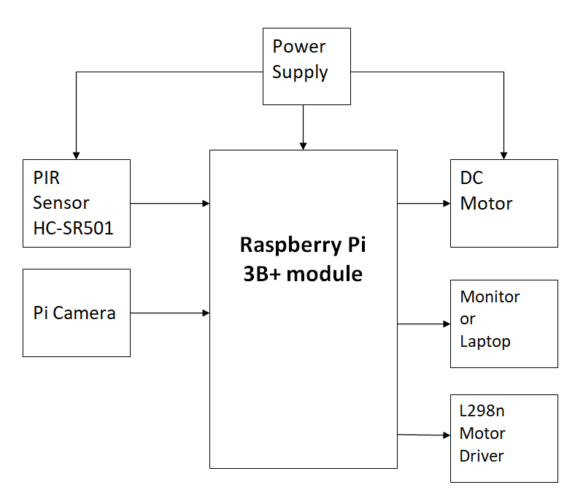
Block Diagram of Security System

Slide 7
Hardware Components
Raspberry Pi(3B+ model)
Pi Camera
PIR Sensor(HC-SR501)
DC Motor(SG90)
L298n Motor Driver
Monitor/Laptop

Slide 8
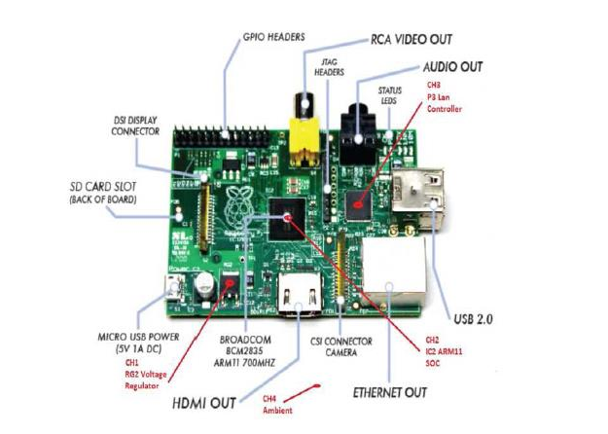
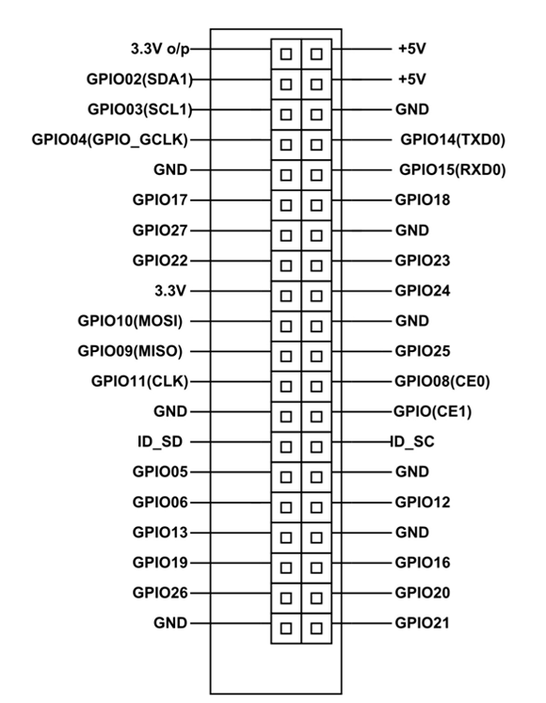
Raspberry Pi

Slide 9
Specification of Raspberry Pi
SoC: Broadcom BCM2837B0 quad-core A53 (ARMv8) 64-bit @ 1.4GHz
RAM: 1GB LPDDR2 SDRAM
Networking: Gigabit Ethernet (via USB channel), 2.4GHz and 5GHz 802.11b/g/n/ac Wi-Fi
Storage: Micro-SD
GPIO: 40-pin GPIO header, populated
Ports: HDMI, 3.5mm analogue audio-video jack, 4x USB 2.0, Ethernet, Camera Serial Interface (CSI), Display Serial Interface (DSI)
Dimensions: 82mm x 56mm x 19.5mm,
Weight: 50g

Slide 10
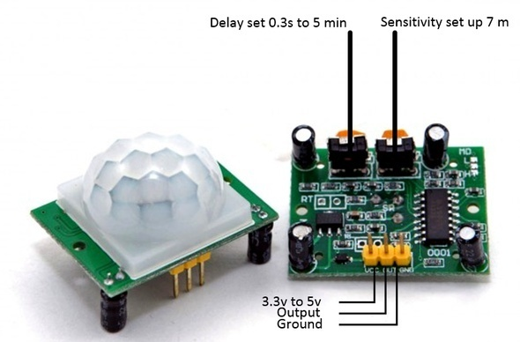
PIR Sensor (HC-SR501)

Slide 11
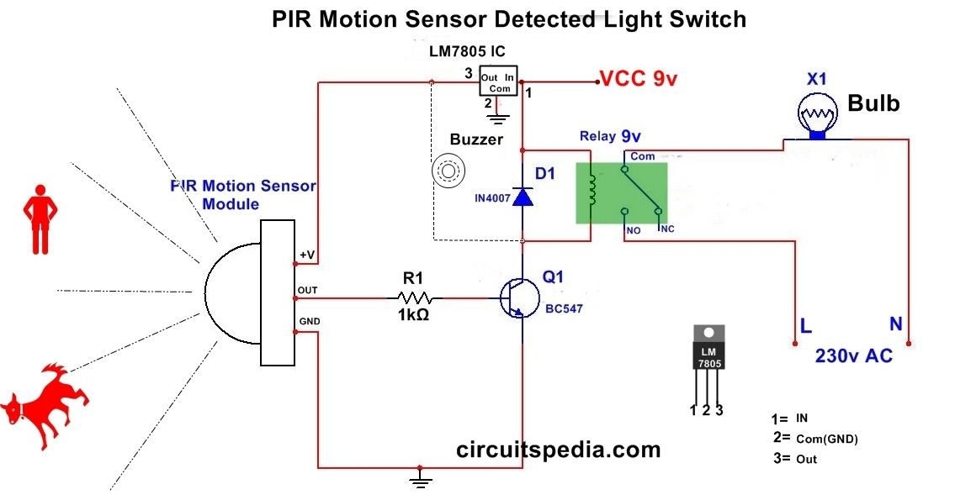
PIR Sensor Circuit:

Slide 12
Specifications of PIR Sensor
Operating Voltage Range: 5 to 20V
Quiescent Current: <50uA
Level output: High 3.3 V /Low 0V
Range of Operation: 5m to 12m
Board Dimensions: 32mm*24mm
Operation Temp.: -15 to +70 degrees
Lens size sensor Diameter: 23mm(Default)

Slide 13
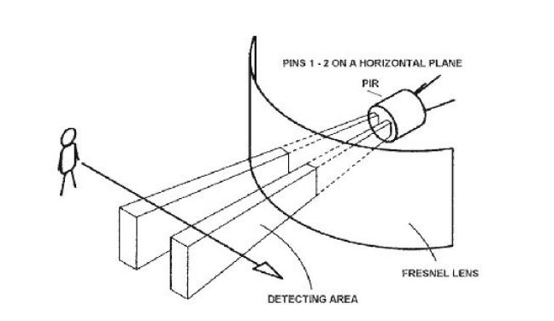
Principle of Operation of PIR Sensor

Slide 14
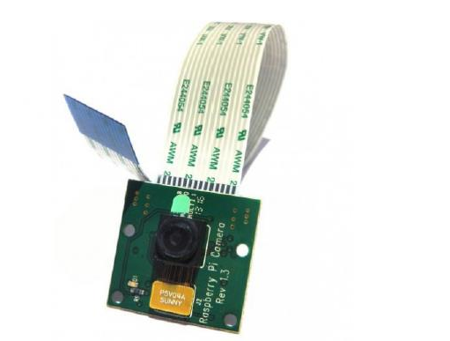
PI Camera

Slide 15
Specifications of PI Camera
Image Sensor: OmniVision OV5647
Resolution: 5-megapixel
Still picture resolution: 2592 x 1944 pixles.
Video Modes: 1080p30, 720p60 & 640x480p60/90
Connection to Raspberry Pi: ribbon cable, to the dedicated Camera Serial Interface (CSI-2).
Temp range Operating: -20º to 60º
Stable image: -20º to 60º
Lens size: 1/4”
Dimensions: 23.86mm x 25mm x 9mm
Weight: 3g

Slide 16
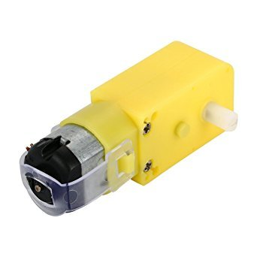
DC Motor

Slide 17
Specifications of DC Motor
Low density: lightweight, low inertia.
Capability to absorb shock and vibration as a result of elastic compliance.
Ability to operate with minimum or no lubrication, due to inherent lubricity.
The relatively low coefficient of friction.
Operating Voltage(VDC): 3~12
Shaft Length (mm): 8.5
Shaft Diameter (mm): 5.5 (Double D-type)
No Load Current: 40-180mA.
Rated Speed(After Reduction): 300 RPM
Rated Torque: 0.35 Kgcm

Slide 18
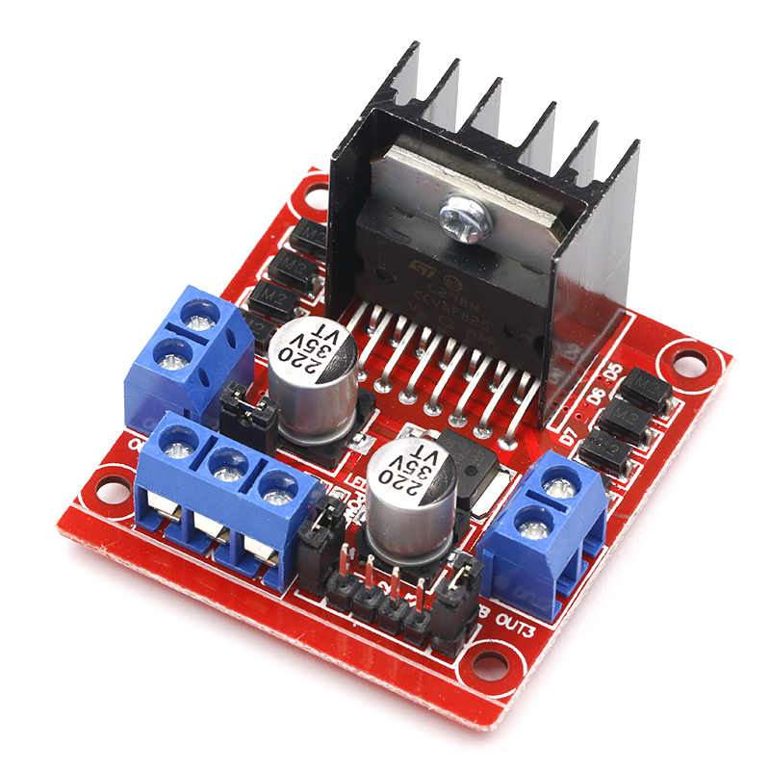
L298n Motor Driver

Slide 19
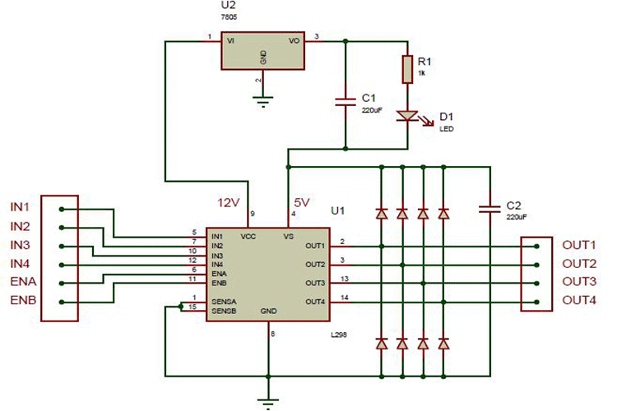
L298n Circuit:

Slide 20
Specifications of L298n Driver Motor
Operating supply voltage up to 46V
Total Dc current up to 4amp (each channel can carry upto 2amp)
Low saturation voltage
Over temperature protection
Logical ”0” input voltage up to 1.5 v (high noise immunity)
PTR connector for easy connection.

Slide 21
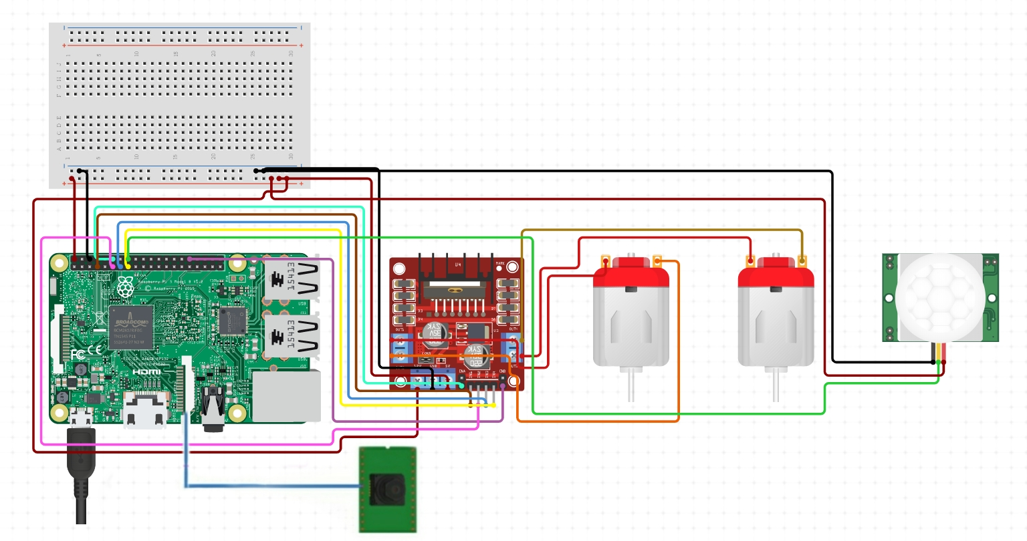
Circuit Connection

Slide 22
Working of System
Raspberry Pi is interfaced with Pi Camera module, PIR sensor and Servo motor. Firstly we create a database of authorised persons and store it in system. Now whenever a person is detected in the specified region the PIR sensor detects and sends a HIGH signal to the Pi.
After receiving the signal the Pi camera is turned ON and starts capturing the images and then it compares the face of the person with the stored data in the database. If the face doesnot match with the authorised users then an alert Email containing the image of the intruder is sent using MIME with SMTP protocols to the specified mailhub & the door remains locked.
If authorised user is recognised then the DC motor & L298n driver motor runs and opens the door.

Slide 23
Software Design
Face recognition is basically the task of recognizing a person based on its facial image.
Face Detection: It has the objective of finding the faces (location and size) in an image.
Face Recognition: with the facial images already extracted, cropped, resized and usually converted to grayscale.
The face recognition systems can operate basically in two modes:
Verification or authentication of a facial image
Identification or facial recognition

Slide 24
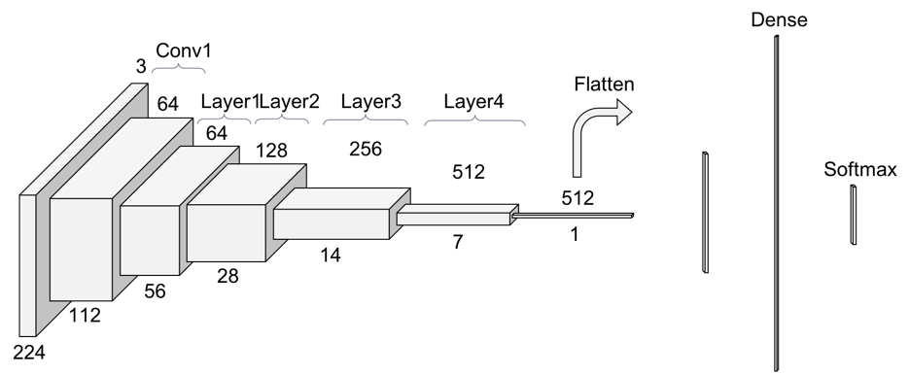
Face Detection
Convolutional Neural Networks:
Convolution..
Non Linearity (ReLU).
Pooling or Sub Sampling.
Classification (Fully Connected Layer).

Slide 25
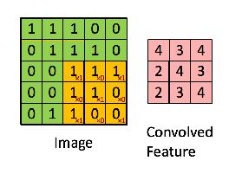


Face Detection cont..
Convolution step
Fig.(a) Pixel values of a 5x5 image.
Fig.(b) 3 x 3 matrix
Fig.(c) The Convolution operation. The output matrix is called Convolved Feature or Feature Map.

Slide 26
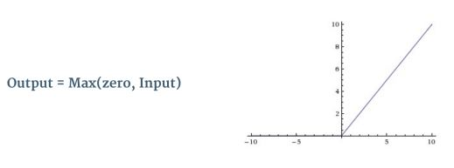
Face Detection cont..
Non-Linearity ReLu Activation
Fig. The ReLU operation

Slide 27
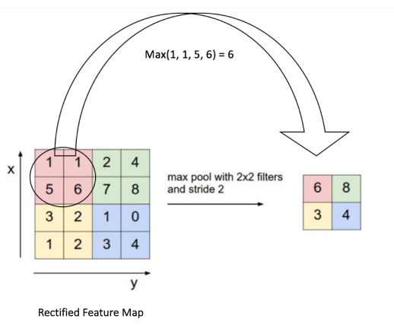
Face Detection cont..
Pooling or Sub Sampling.
Fig. shows an example of Max Pooling operation on a Rectified Feature map (obtained after convolution + ReLU operation) by using a 2×2 window.

Slide 28
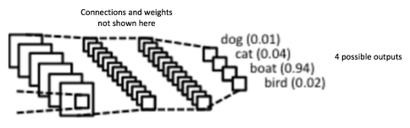
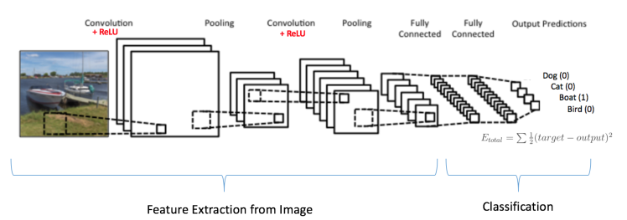
Face Detection cont..
Classification (Fully Connected Layer).
Fig.(a) Fully Connected Layer -each node is connected to every other node in the adjacent layer.
Fig.(b) Training the ConvNet

Slide 29
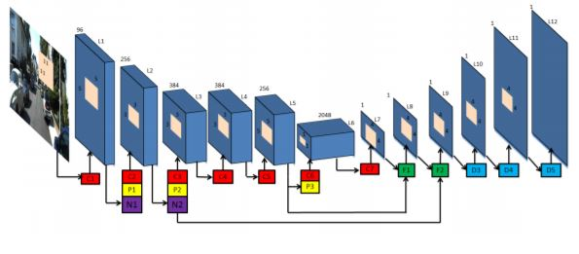
Face Detection cont..
Visualizing Convolutional Neural Networks:
Residual Neural Network (ResNet): It is a classic neural network used as a backbone for many computer vision tasks.
Skip Connection - The Strength of ResNet:

Slide 30
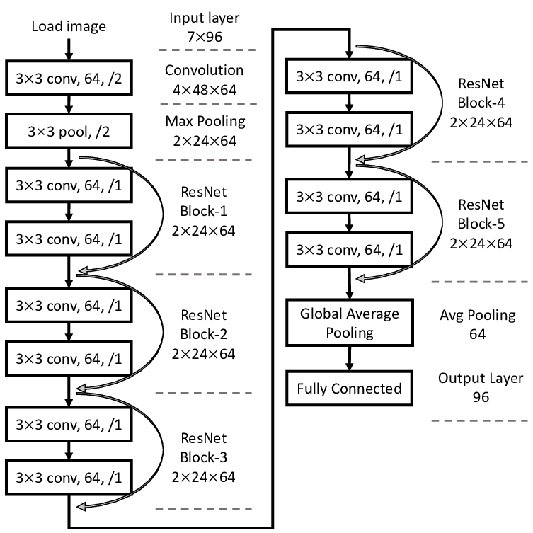
Face Detection cont..
ResNet Architecture:

Slide 31
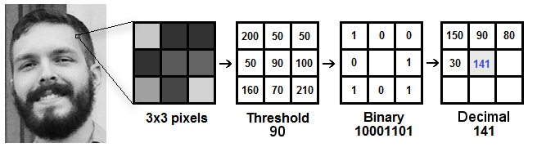
Face Recognition
Local Binary Pattern Histogram(LBPH): which labels the pixels of an image by thresholding the neighborhood of each pixel and considers the result as a binary number.
Training the Algorithm
Applying the LBP operation

Slide 32
PYTHON PROGRAMMING LANGUAGE
Python is an interpreted, high-level, general-purpose programming language. Created by Guido van Rossum.
Python Libraries:
OpenCV
Numpy
OS
SMTP Lib
E-mail and MIME handling package

Slide 33
E-mail Notification
In order to allow for email notifications to send, the OS needs a program that allows for emails to be sent.
So we need 2 protocols for this operation
i.Simple Mail Transfer Protocol(SMTP).
ii.Multipurpose Internet Mail Extension(MIME).

Slide 34
Simple Mail Transfer Protocol(SMTP)
SENDING EMAIL: The message which is sent across consists of a header and the body. It’s used to send message which is a sequence of ASCII characters.
RECEIVING EMAIL: The user agent at the server side checks the mailboxes at a particular time of intervals. If any information is received it informs the user about the mail.

Slide 35
Multipurpose Internet Mail Extension (MIME) Protocol
MIME is a kind of add on or a supplementary protocol which allows non-ASCII data to be sent through SMTP.
Features of MIME –
It is able to send multiple attachments with a single message.
Unlimited message length.
Binary attachments (executables, images, audio files) which may be divided if needed.

Slide 36
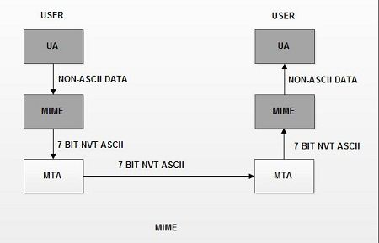
Working of MIME

Slide 37
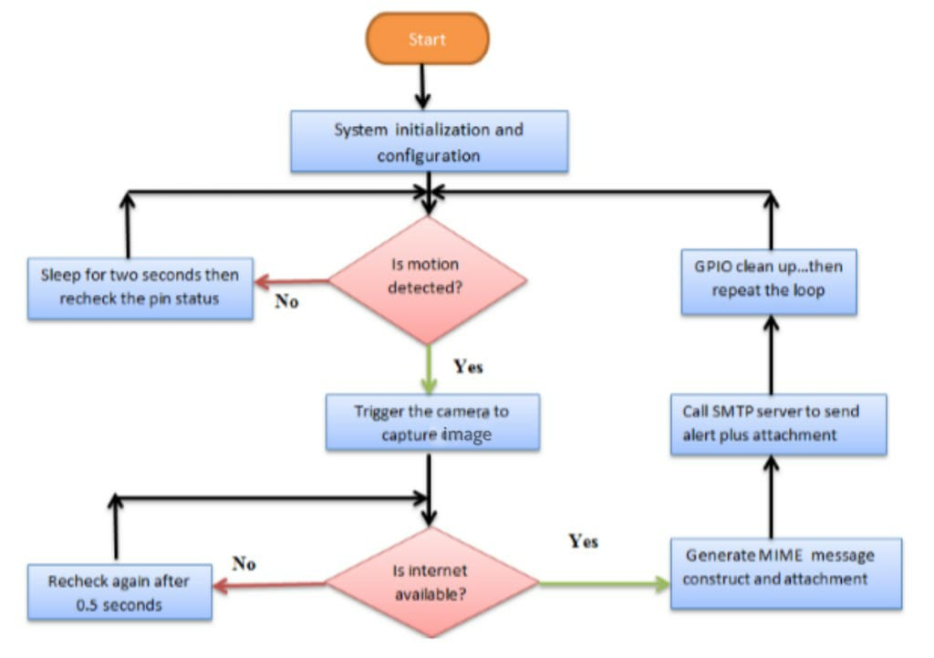
Flowchart for Object detection & E-mail Notification

Slide 38
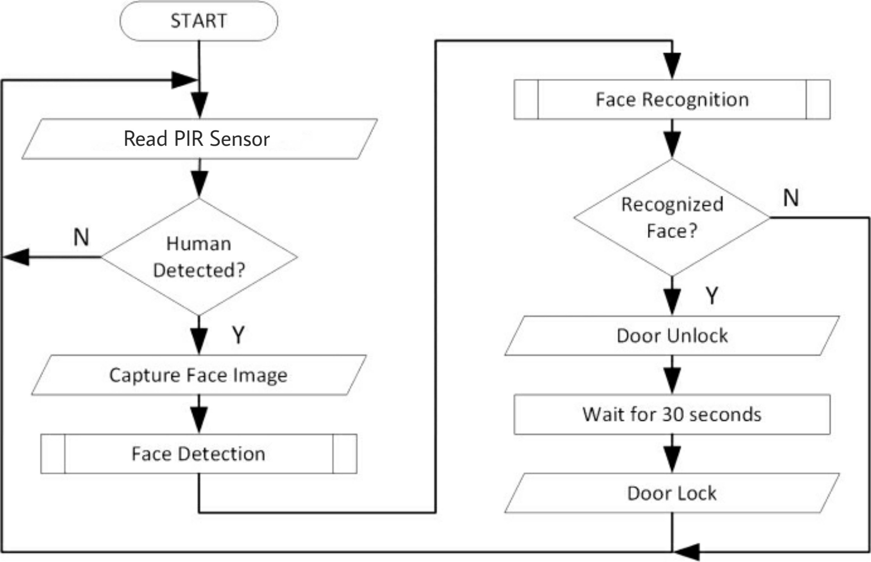
Flowchart for Door Unlocking

Slide 39
ALGORITHM FOR DOOR UNLOCKING
Read PIR Sensor.
If any human is detected then capture image and run face recognition.
If captured face is recognized then unlock the door or else keep it locked and keep reading PIR sensor.
Wait for a specified time and lock the door.
Repeat.

Slide 40
CODE IMPLEMENTATION
datasetcreate.py
trainer.py
raspFunctions.py
main.py

Slide 41
Advantages
It can be used to monitor private properties from wherever they are in the world.
Maintain records of authorised users.
Helps user to take instant right decisions whenever an intruder is found.
This comes at a low cost compared to CCTV.

Slide 42
Disadvantages
The camera can be vulnerable i.e can be stolen/damaged.
Privacy is an issue.

Slide 43
Applications
It provides security for houses, industries & educational institutes etc.
It can be used to keep track on the users.
It can be used to monitor any remote area.

Slide 44
References
1. M. Peter and H. David, “Learn Raspberry Pi with Linux” Apress, 2012.
2. P. S. Dhake and B. Sumedha S., “Embedded Surveillance System Using PIR Sensor.,” vol. No. 02, no. 3, 2014.
3. J. D., “Real Time Embedded Network And SMS Alerting system,” Jun. 2014
Russel, S. and Norvig, P. (2003). Artifiical Intelligence: A Modern Approach. 2nd Edition. New York: Prentice-Hall.
Schmidhuber, J. (2015). Deep Learning in Neural Networks: An Overview. Neural Networks 61: 85-117.
Adrian Rosebrock (2018). Face detection with OpenCV and deep learning. www.pyimagesearch.com
Arjun Krishna Babu (2016). Send Emails Using Python. freecodecamp.org

